Slide 1
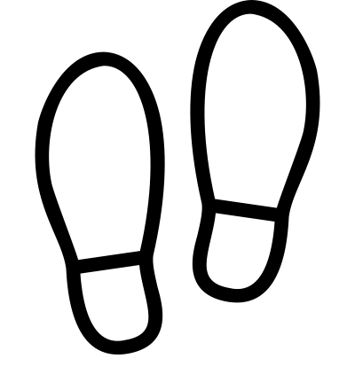
Integrated youth health hub
Project background
The Eastern Melbourne PHN (Primary Health Network, EMPHN) has received funding from the Commonwealth Department of Health to develop a Health Hub targeting young people in Shire of Yarra Ranges. The purpose of the Health Hub is to provide young people and their families access to range of primary health services such as mental health, drug and alcohol and physical health services in an integrated manner. It is anticipated that the Health Hub will commence operations in mid-2020.
EMPHN has engaged Impact Co. and Swagata Bapat Consulting to support the development of the service model that will underpin the design of the Health Hub. A high-level draft of the service model is described on the following pages, including details on the:
Target cohort of the Heath Hub
Services that will be delivered from the Health Hub
Operating hours of the Health Hub
Service delivery locations of the Health Hub
Key principles underpinning the Health Hub
Key elements of the build structure for the Health Hub
User journey of young people through the Health Hub and the key features of each stage of the user journey
This draft has been developed based on insights gathered through the following activities:
1
2
3
4
Stakeholder consultations
The consultations attempted to capture the voice of a diverse group of young people. In total, 45 young people and 14 staff members (from 7 different service providers) were engaged during the consultations.
Literature review
Desktop research on available literature across Australia and internationally
Site visit
Site visit to the Visy Cares Hub in Sunshine and interview with the hub’s Operations and Facility Manager
Co-design workshop
Co-design workshop attended by 19 participants including young people, service providers and representatives from EMPHN
The last page of this document invites feedback from stakeholders on the high-level draft service model developed
Continued on the following page…

Slide 2
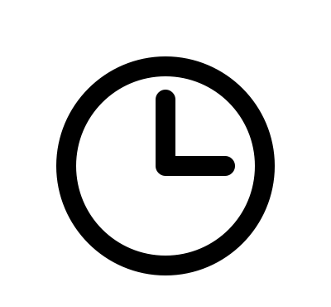
Integrated youth health hub
Service model
The service model of the Health Hub and key principles underpinning are depicted below:
SERVICES
The core services offered through the Health Hub will focus on enhancing the health and wellbeing of young people and will include:
SERVICE LOCATION
The Health Hub will consist of a main site in Lilydale, and multiple other sites across the Yarra Ranges to ensure that young people from different parts of the catchment can readily access services.
Mental health
Sexual health
Alcohol and other drugs
Life skills development (e.g. cooking, eating healthy)
Health and wellbeing promotion
Physical health services (including allied health services and fitness activities)
TARGET COHORT
The target cohort of the Health Hub is all young people aged 12 – 25 years old in the Yarra Ranges catchment. There will also be a proactive focus on ensuring access to those who are at-risk, disadvantaged and with complex needs.
SERVICE HOURS
The Health Hub will operate during hours that are accessible to young people i.e. operating hours will need to extend to after hours (after 5pm on weekdays and on weekends)
In addition, it is envisaged that the Health Hub will have strong links and regularly host other social and youth-related services (such as legal aid, family violence, employment, housing, education, disability and Centrelink).
Services delivered at the Heath Hub will include 1-on-1 and group-based activities and will also have a strong focus on prevention and early intervention
Holistic and Responsive to NEED
Services available at the Health Hub will be person-centred, focusing on supporting the broad health and wellbeing needs of young peopled. Where appropriate, services at the Health Hub will also be able to involve families.
A Stepped Care approach will be implemented to adapt to a young person’s changing needs
Safe and inclusive
Services, facilities, infrastructure and approaches/models of care adopted at the Health Hub will be designed to be inclusive to young people of all backgrounds, abilities and identities.
Youth-led
A core focus of the Health Hub will be to involve young people in the design and delivery of activities at the Health Hub. The concept of youth-led will also extend to involving young people in the governance of the Health Hub and providing peer support to other young people accessing services at the Health Hub.
Collaborative with shared accountability
Services at the Health Hub will work together in an integrated manner, where there is shared accountability to enhance the health and wellbeing of young people.
Evidence-based Quality CARE
Services at the Health Hub will be underpinned by evidence-informed practices to deliver safe and high-quality care to young people.
Key principles underpinning the Health Hub

Slide 3
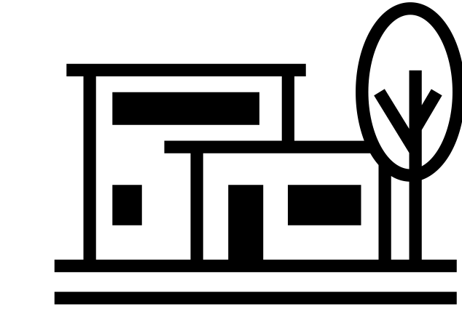
Integrated youth health hub
BUILT STRUCTURE ELEMENTS
Key elements of the design and layout for the Health Hub are depicted below:
Accessible
Sites of the Health Hub should be close to public transport, centrally located to the area and visible with consistent branding across the sites.
Inclusive
The Health Hub will:
Be accessible for people with a disability and compliant with the Disability Discrimination Act (DDA)
Accredited or working towards accreditation under the Rainbow Tick (including using gender-neutral language and having gender neutral toilets)
Be culturally appropriate for individuals who are of an Aboriginal and Torres Strait Islander or CALD background
Provide access to interpreters where necessary and take into consideration the different language needs
Youth-friendly
The following will be provided at the Health Hub to create a ‘youth-friendly’ environment for young people:
Charging stations
Changing Rooms
Access to free wi-fi
Artwork produced by young people
Music
Having food available
Washing machine
Safe
The Health Hub will have:
Clearly identified security cameras
On-site security during appropriate operating hours
Soft lighting
Different access points for crisis situations
Connected to the environment
The Health Hub will have greenery in indoor spaces with access to different outdoor spaces or a community garden where possible. It will also be operated in an environmentally friendly way.
Continued on the following page…

Slide 4
Integrated youth health hub
User journey
The user journey of young people through the Health Hub and the key features of each stage of the user journey is depicted below:
!
AWARENESS
Young person becomes aware of the Health Hub
Key features:
Recognisable - The Health Hub will have its own identity/brand to make it more identifiable/relatable amongst young people.
Proactive – Direct and indirect marketing and communication initiatives.
Simple – Language used in communication material for the Health Hub will be accessible to young people.
ENGAGEMENT
Young person begins to engage with the Health Hub through recreational and capacity building activities.
Key features:
Engaging - A significant emphasis will be placed on engaging young people through activities around skills development, employment and recreation.
Choice and control – Young people will be supported and empowered to make decisions about their service needs.
REFERRAL, INTAKE AND ASSESSMENT
The young person is referred or self-refers to a specific service(s) offered at the Health Hub. The young person goes through the intake and assessment process.
Key features:
Flexible - Referral of young people into the Health Hub will occur through multiple channels (including referral through family/friends and self-referral).
Streamlined – The intake process at the Health Hub will be centralised.
Tiered – The information gathering and risk assessment process will be tailored according to the needs/context of the young person
Responsive – Waitlists will be minimised as much as possible and matched to need. Young people will be triaged to ensure that those with more urgent and complex needs are supported first. Young people on waitlists will be supported through group programs/activities.
SERVICE DELIVERY AND REVIEW
Young person accesses a specific needs-based service(s) at the Health Hub
Key features:
Integrated – Services will be delivered in an integrated and coordinated manner (this includes linking young people with external services as required).
Shared governance – Strategic and operational governance will be the collective responsibility of services at the Health Hub.
Regular reviews – There will be ongoing and regular review of the (i) needs of and (ii) outcomes achieved for young people being supported.
Peer support - Peer support will be made available to young people accessing services at the Health Hub
SERVICE EXIT
Young person no longer requires services from the Health Hub
Key features:
Continuity of support –Appropriate community supports matched to need should be in place on exit from the Hub. Where necessary, follow-ups with the young person will also be scheduled.
Ease of re-entry – Once having accessed services at the Health Hub, young people needing to re-enter the service will be offered a streamlined re-entry, avoiding the need for them to retell their story.

Slide 5
Integrated youth health hub
Have your say
Upon reviewing the information presented in the preceding pages, it’ll be useful to get feedback on the following:
What are your general thoughts on the high-level draft service model?
Are there key elements that are missing from the high-level draft service model?
What facilities/design considerations would be required at the Health Hub to deliver the identified services effectively (e.g. small private and soundproof consulting rooms, space for group programs, shared desk space etc)?
You can provide feedback at https://www.surveymonkey.com/r/Lilydaleyouthfeedback by 30 January 2020

